Slide 1
Introduction to SPSS
Presented by : edgar
For Statistical and financial accounting class
Notes:
Dubai FGF-008 (ground floor of F-wing)

Slide 2
Outline
Review of Concepts (stats and scales)
Data entry (the workspace and labels)
By hand
Import Excel
Running an analysis- frequency, central tendency, correlation

Slide 3
Types of Statistics
Descriptive- summarize or describe our observations
Inferential- use observations to allow us to make predictions (inferences) about a situation that has not yet occurred
Notes:
Nearly everything you do will probably use inferential stats- in spss is it doesn’t you will select descriptive stats
Give some examples in the room – stats are something we use all the time- ages, height, grades etc

Slide 4
Descriptive or Inferential?
I walk about 50 km per week on average.
We can expect a lot of rain this time of year.
I consume 4 Chapatis in one seating
Notes:
A descriptive
B is inferential because it is making a prediction based upon past observations

Slide 5
Population vs Sample
A population refers to all the cases to which a researcher wants his estimates to apply to
cars, people, students
A sample is used because it is normally impossible to study all the members of a population
Descriptive stats simply summarize a sample
Inferential stats generalize from a sample to the wider population
Notes:
The other way descriptive stats and inferential stats differ

Slide 6
Variables
Samples are made up of individuals, all individuals have characteristics. Members of a sample will differ on certain characteristics. Hence, we call this variation amongst individuals variable characteristics or variables for short.
Notes:
Labeling and enter your variables in SPSS is much of this first session

Slide 7

Types of Variables
What are variables you would consider in buying a second hand bike?
Brand (Trek, Raleigh,Avon)
Type (road, mountain, racer)
Components (Shimano, no name)
Age
Condition (Excellent, good, poor)
Price
Frame size
Number of gears
Notes:
Lets put these data types in groupings- categories & numbers

Slide 8
Types of Scales
Nominal- objects or people are categorized according to some criterion (gender, job category)
Ordinal- Categories which are ranked according to characteristics (income- low, moderate, high)
Interval- contain equal distance between units of measure- but no zero (calendar years, temperature)
Ratio- has an absolute zero and consistent intervals (distance, weight)
Notes:
Interval and ratio are real numbers
Issues arise when we try to apply parametric stats to ordinal- ie) likert scales

Slide 9
Parametric vs Non-parametric
Parametric stats are more powerful than non-parametric stats- for real numbers- T test
Non-parametric stats are not as powerful but good for category variables - Mann-Whitney U (likert)
Notes:
Parametric- you have a better chance of recognizing chance vs actual patterns in the datayou have a better chance of recognizing chance vs
Tell story about Likert scales t test

Slide 10
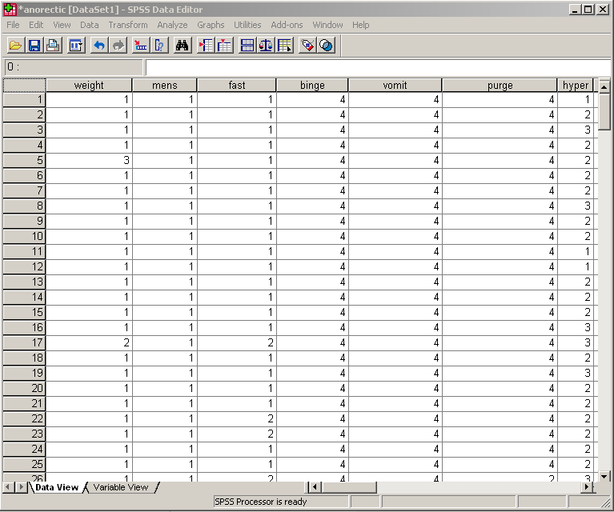
The SPSS Workspace
Variables
Cases
Toggle between Data and Variable Views
Notes:
Save as you go

Slide 11
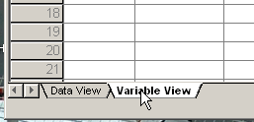
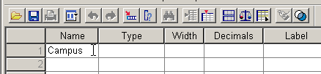
Data Entry (by hand)
1. Click Variable View
2. Click the Row 1, Name cell and type Campus (no spaces allowed in name)

Slide 12
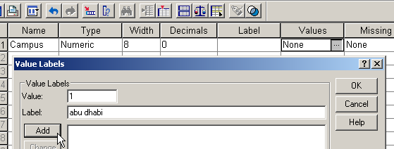

Data Entry (by hand)
3. Click the Row 1, Values cell and type 1 for the value and abu dhabi for the label- click Add
4. Type 2 for the value and dubai for the label- click Add and then OK
Notes:
Note the scales-option real numbers or not will effect what you can do

Slide 13
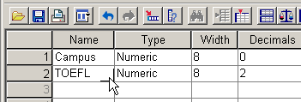

Data Entry (by hand)
5. Click the Row 2, Name cell and type TOEFL
6. Click the Row 2, Label cell and type Paper based TOEFL Scores

Slide 14


Data Entry (by hand)
7. Click the Row 3, Name cell and type IELTS
8. Click the Row 4, Name cell and type Gender

Slide 15
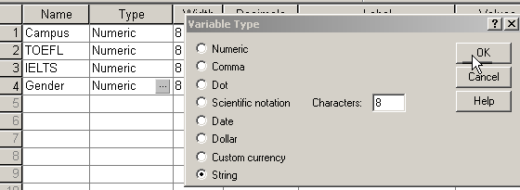
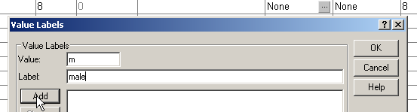
Data Entry (by hand)
9. Click the Row 4, Type cell and click String and click OK
10. Click the Row 4, Values cell and type m for the value and male for the label- click Add

Slide 16


Data Entry (by hand)
11. Type f for the value and female for the label- click Add and then OK (notice the measure is now nominal)
12. Click Data View in the bottom left corner to start entering the data

Slide 17
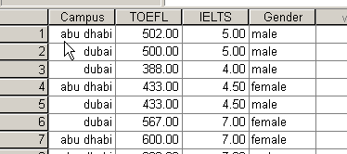
Data Entry (by hand)
13. Click on the cells and enter the data (either type numbers of select from the dropdown menu)

Slide 18
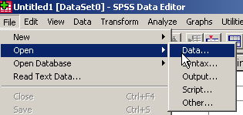
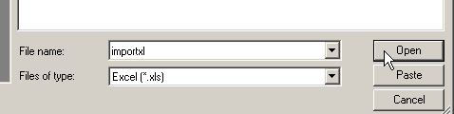
Data Entry (import from Excel)
14. Click Open- Data…
15. Change Files of type to Excel, then browse and open the file.
SPSS- Tutorial- Sample Files
Notes:
Use xl demo inside Tutorial- sample files

Slide 19
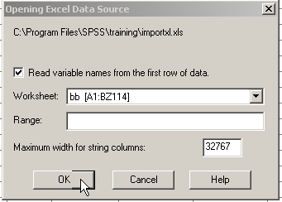
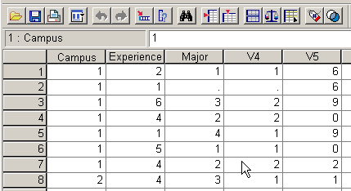
Data Entry (import from Excel)
16. Select the worksheet, the range (if desired), and if to read variable names- click OK
The data and variable names will appear

Slide 20
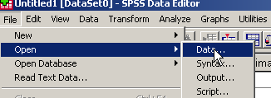
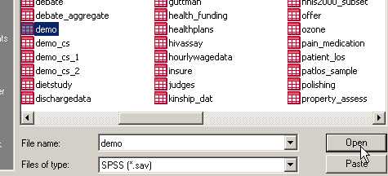
Running Analyses
17. With SPSS open, select file- Open- Data
18. Navigate to SPSS- Tutorial- sample_files- select demo, click Open

Slide 21
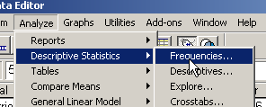
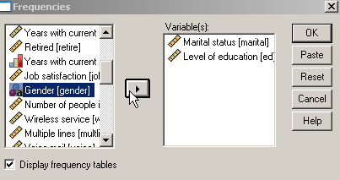
Running Analyses (Frequency)
19. Select Analyze- Descriptive Stats- Frequencies
20. Select the desired variables and click the arrow to move them to the right side

Slide 22

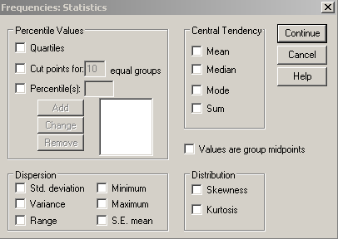
Running Analyses (Frequency)
21. Click Statistics
22. Select any stats that you want to see, click Continue

Slide 23

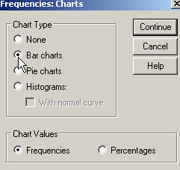
Running Analyses (Frequency)
23. Click Charts
24. Select the type of chart you want, click Continue, then OK

Slide 24
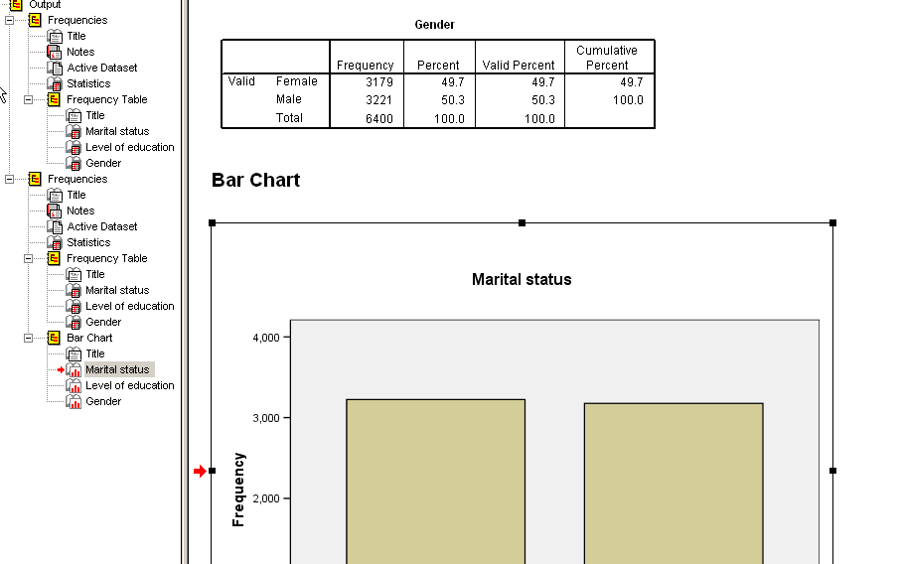
Running Analyses (Frequency)
Result Tables and Graphs will appear

Slide 25

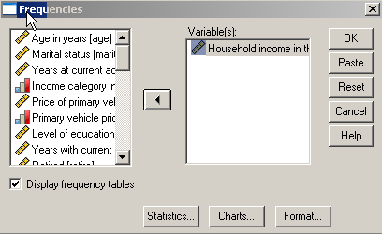
Running Analyses (Central Tendency)
25. Select Analyze- Descriptive Stats- Frequencies
26. Select the desired variables (household income) and click the arrow to move them to the right side

Slide 26
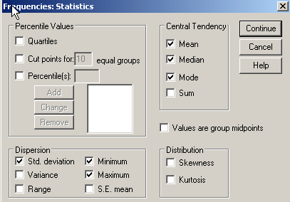
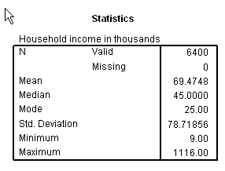
Running Analyses (Central Tendency)
27. Select some measures of central tendency and dispersion- click Continue then OK
Results will appear

Slide 27
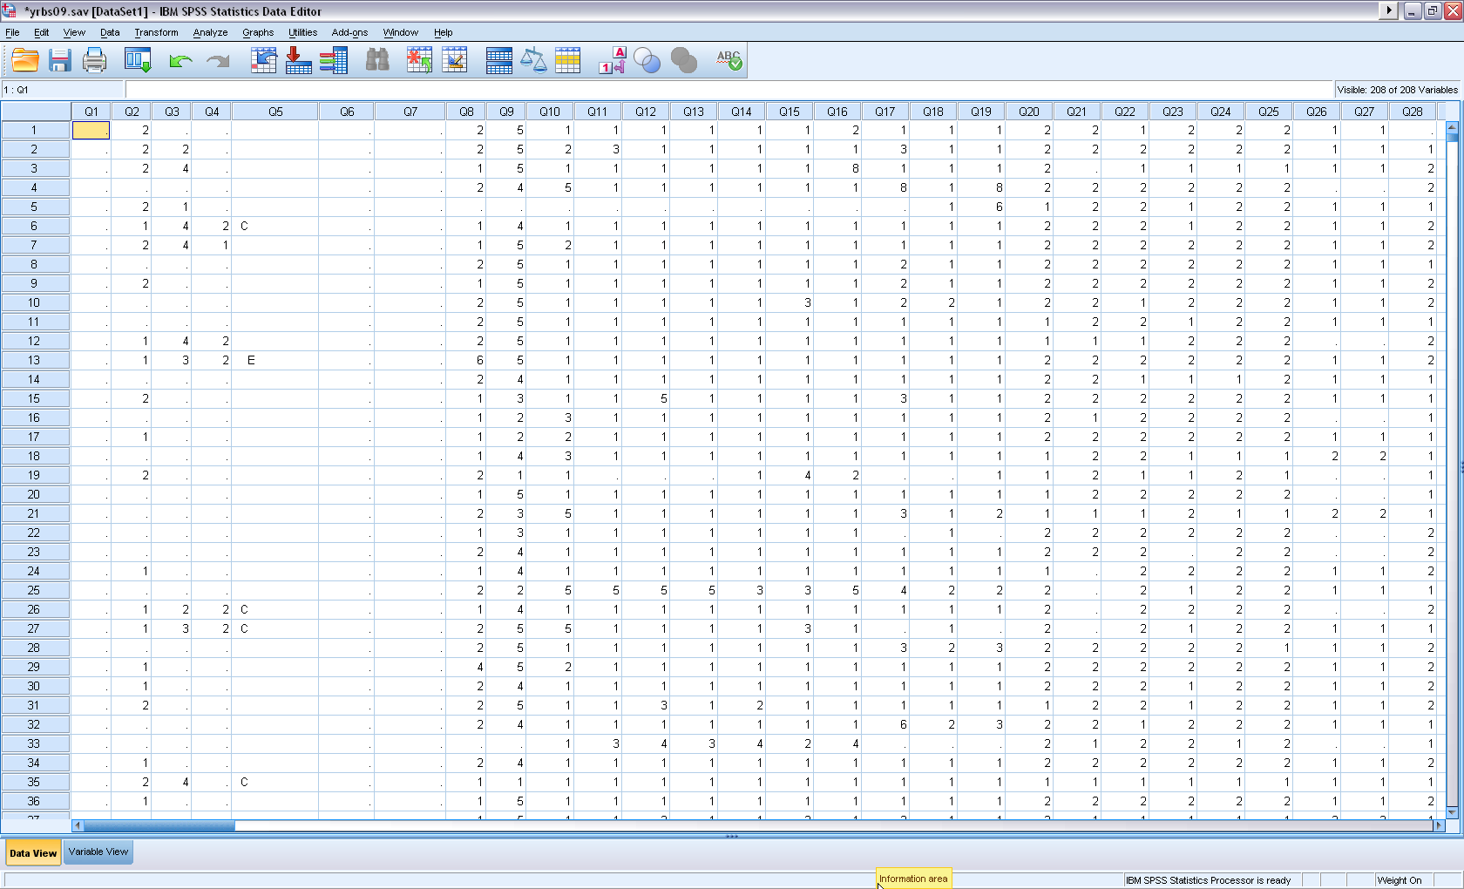
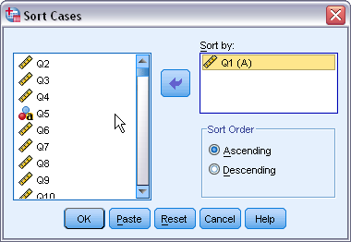
Sort and select cases
Sort cases by variables: Data Sort Cases
You can use Sort Cases to find missing.

Slide 28
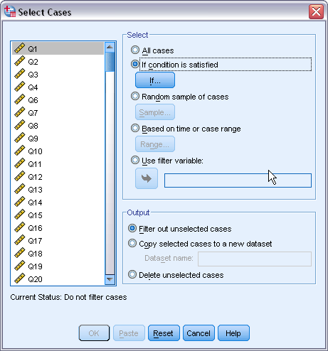
Sort and select cases
Select cases
Example 1. Select Females for analysis.
Go to Data Select Cases
Under Select: check the second one
Click If button

Slide 29
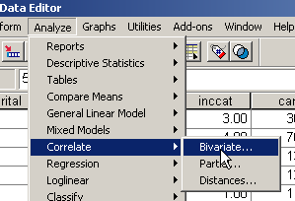
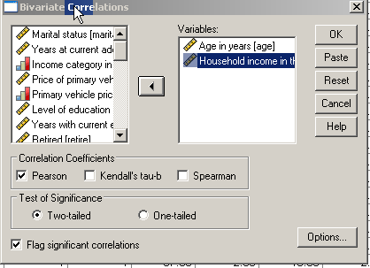
Running Analyses (Correlation)
28. Click Analyze- Correlate- Bivariate
29. Move the two variables of interest to the right side (age & income), click OK
Notes:
Use statistics coach as an example
Keep the default settings- Pearson is for interval or ratio data
Spearman is for dichotomous

Slide 30
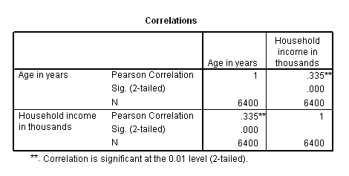
Running Analyses (Correlation)
30. Results appear and tell us that the relationship is weak to moderate and results are not due to chance
Notes:
R=.335 (weak to moderate)
The significance of a correlation coefficient is not a determination of the strength of the relationship. Significance means, as always, that the observed value most likely did not occur by chance.

Slide 31
1. Skewness: a measure of the asymmetry of a distribution.The normal distribution is symmetric and has a skewness value of zero.
Positive skewness: a long right tail.
Negative skewness: a long left tail.
Departure from symmetry : a skewness value more than twice its standard error.
2. Kurtosis: A measure of the extent to which observations cluster around a central point. For a normal distribution, the value of the kurtosis statistic is zero.
Mesokurtic data vales are with a normal curve/distribution
Leptokurtic data values are more peaked, whereas
platykurtic data values are flatter and more dispersed along the X axis.

Slide 32
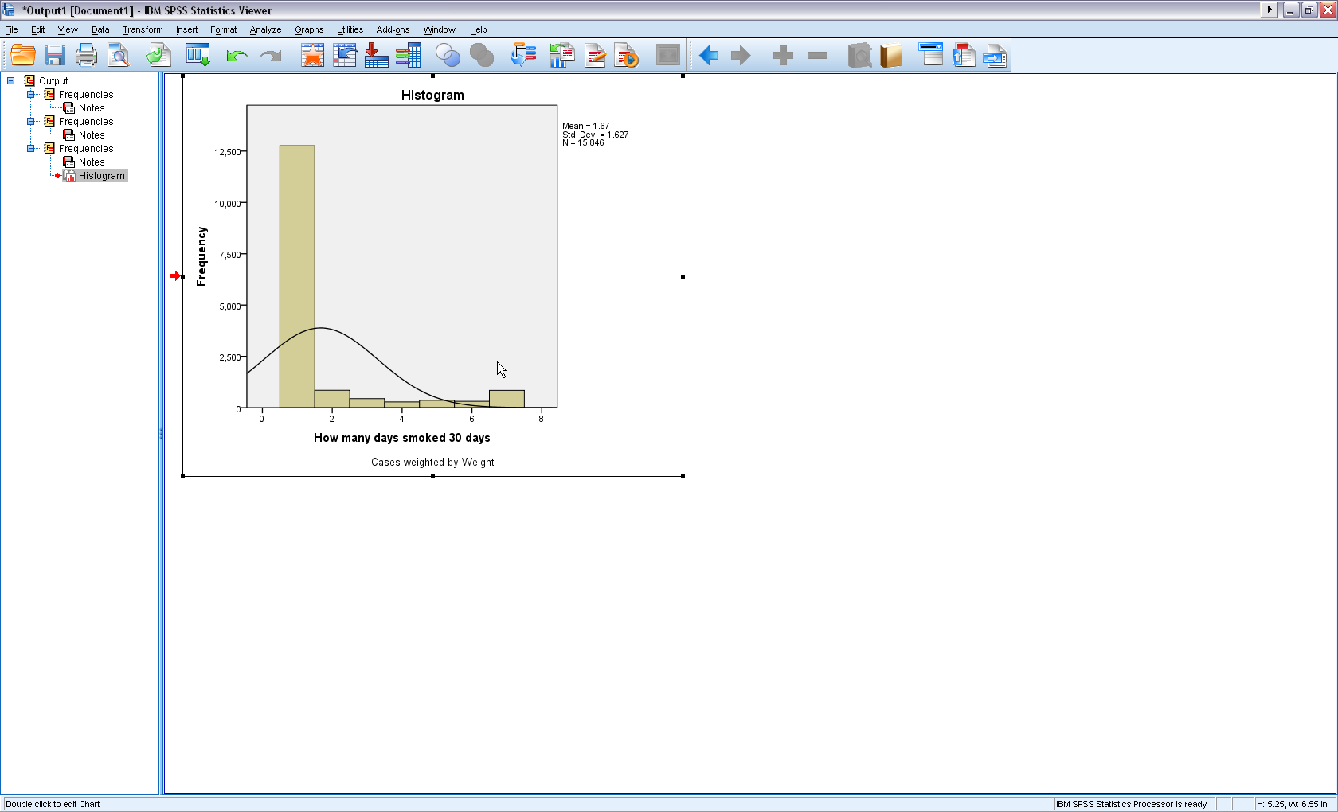
Nature of curve

Slide 33
Resources
Texas A & M- a huge selection of helpful movies http://www.stat.tamu.edu/spss.php
UCLA- SPSS 17.0 Starter Kit (useful movies, FAQs, etc) http://www.ats.ucla.edu/stat/spss/sk/default.htm
Indiana University- Getting Started (useful instructions with screenshots)
http://www.indiana.edu/~statmath/stat/spss/win/
University of Toronto- A Brief Tutorial (screenshots, instructions and basic stats)
http://www.psych.utoronto.ca/courses/c1/spss/page1.htm
Central Michigan- Tutorials and Clips (movies, screenshots, instructions- slow loading but good)
http://calcnet.mth.cmich.edu/org/spss/toc.htm
SPSS Statistics Coach and Tutorial (under Help) as well as the ZU library
Online Statistics Textbook
http://www.statsoft.com/textbook/stathome.html

